Slide 1




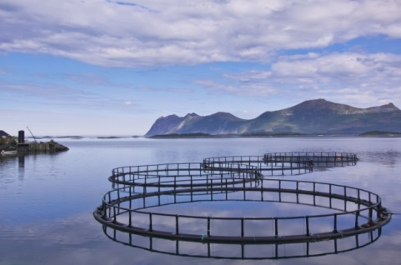
GRINNAQUA – GENOMICS WORKSHOP
Porto, 16th & 17th March 2023

Slide 2
Overview of the genomics pipeline
Raw sequencing
Quality control
(fastp)
Estimation of gene expression
(kallisto)
Differential expression analysis
(DESeq2)

Slide 3
Overview of the genomics pipeline
Raw sequencing
Quality control
(fastp)
Estimation of gene expression
(kallisto)
Differential expression analysis
(DESeq2)

Slide 4
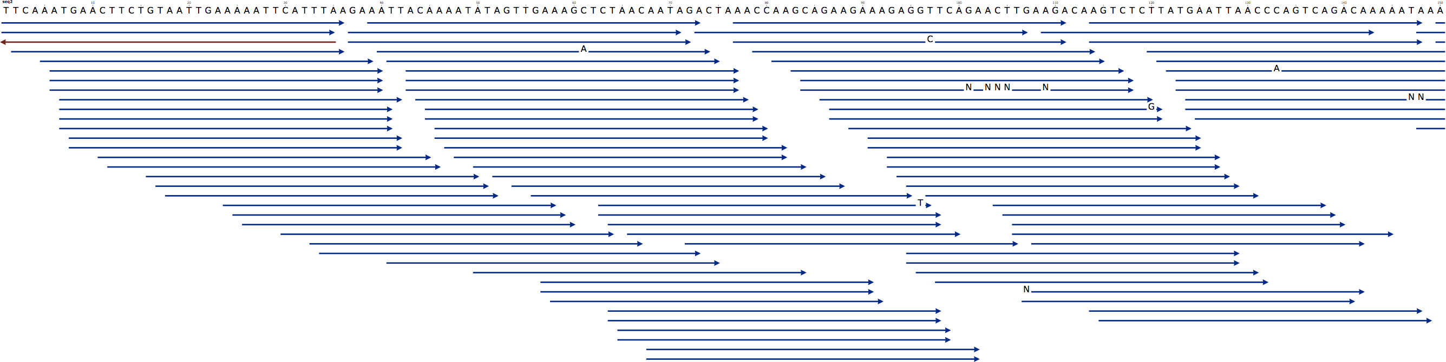
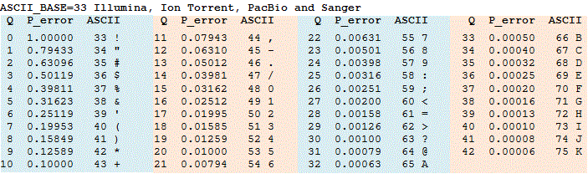
FASTQ files – the beginning of all genomics pipelines
1) A sequence identifier with information about the sequencing run and the cluster. Can vary depending on software used to demultiplex
2) The sequence
3) Just a separator
4) The base call quality scores. These are Phred +33 encoded, using ASCII characters to represent the numerical quality scores
A quality score of 20 (Q20) represents an error rate of 1 in 100 (meaning every 100 bp sequencing read may contain an error), with a corresponding call accuracy of 99%.

Slide 5
Overview of the genomics pipeline
Raw sequencing
Quality control
(fastp)
Estimation of gene expression
(kallisto)
Differential expression analysis
(DESeq2)

Slide 6
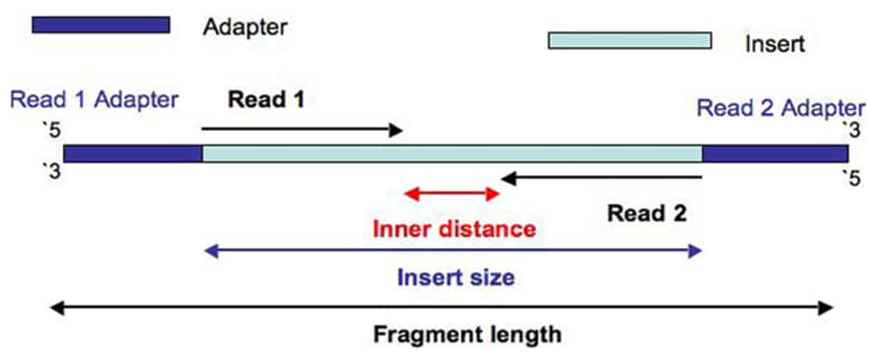
FASTQ files – the beginning of all genomics pipelines
We usually talk about read 1 and read 2, or left reads and right reads
Fastq files are usually PAIRED

Slide 7
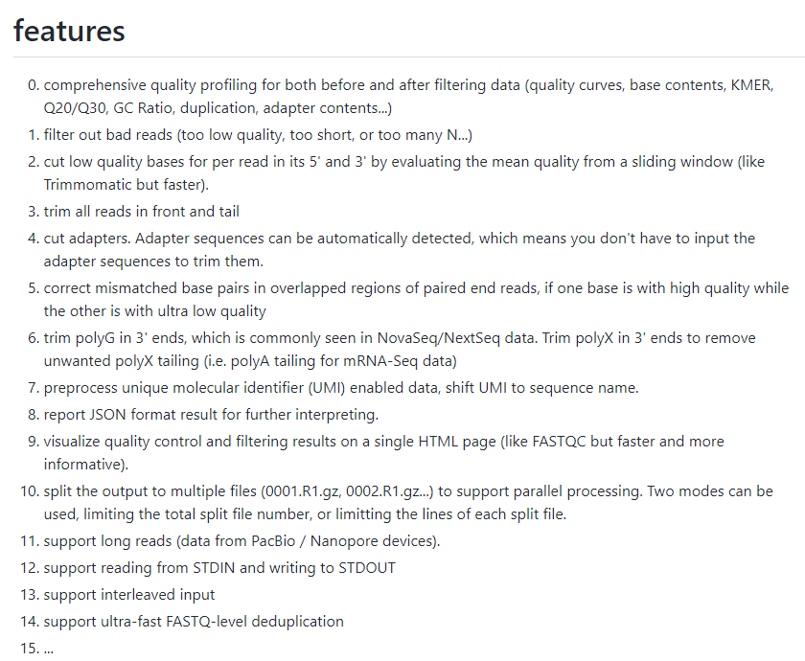
Quality control – remove low quality bases and reads
Fastp - fast all-in-one preprocessing for FastQ files (https://github.com/OpenGene/fastp)

Slide 8
Overview of the genomics pipeline
Raw sequencing
Quality control
(fastp)
Estimation of gene expression
(kallisto)
Differential expression analysis
(DESeq2)

Slide 9
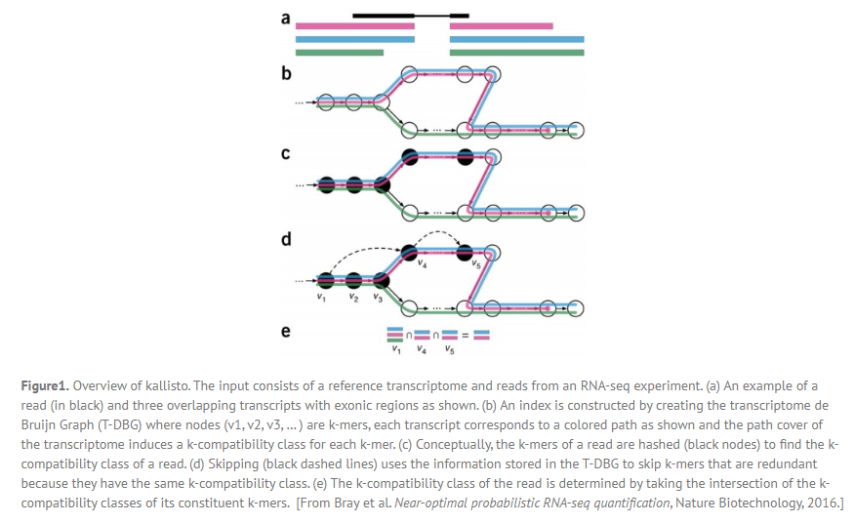
Kallisto - pseudoalignment against a transcriptome to estimate expression
(https://pachterlab.github.io/kallisto/)
Estimation of gene expression
+
Faster, less resource intensive and as accurate as traditional aligners
-
Only for gene expression analyses, not valid for other downstream analysis

Slide 10
Overview of the genomics pipeline
Raw sequencing
Quality control
(fastp)
Alignment against the genome
(STAR)
Estimation of gene expression
(kallisto)
SNP calling
Allelic specific expression
Alternative splicing
Differential expression analysis
(DESeq2)

Slide 11
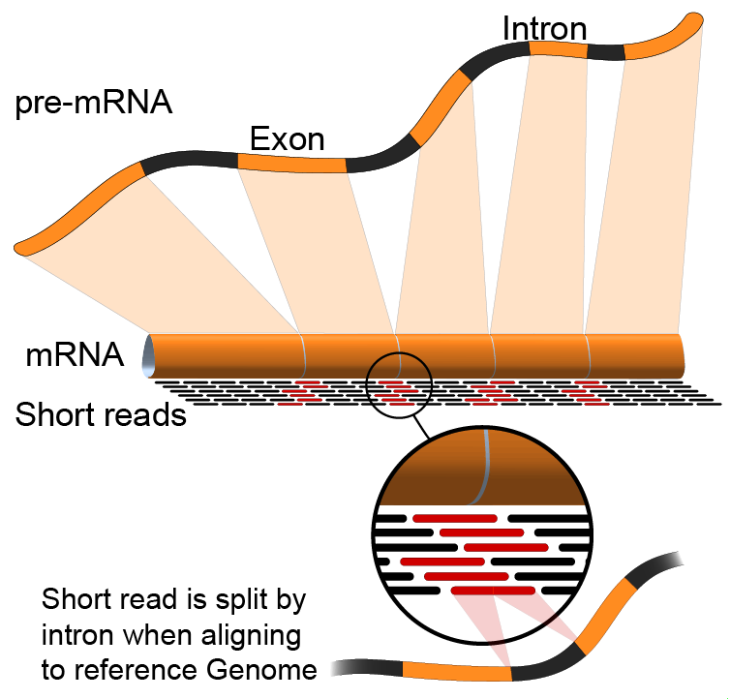
STAR – Spliced Transcripts Alignment to a Reference (https://github.com/alexdobin/STAR)
+
Faster, less resource intensive and as accurate as traditional aligners
-
Only for gene expression analyses, not valid for other downstream analysis

Slide 12
Overview of the genomics pipeline
Raw sequencing
Quality control
(fastp)
Alignment against the genome
(STAR)
Estimation of gene expression
(kallisto)
SNP calling
Allelic specific expression
Alternative splicing
Differential expression analysis
(DESeq2)

Slide 13
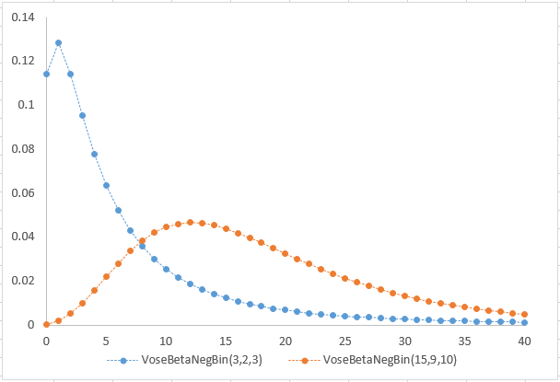
DESeq2 – testing for differential expression using negative binomial distributions
https://bioconductor.org/packages/release/bioc/vignettes/DESeq2/inst/doc/DESeq2.html

Slide 14
Overview of the genomics pipeline
Raw sequencing
Quality control
(fastp)
Alignment against the genome
(STAR)
Estimation of gene expression
(kallisto)
SNP calling
Allelic specific expression
Alternative splicing
Differential expression analysis
(DESeq2)

Slide 15
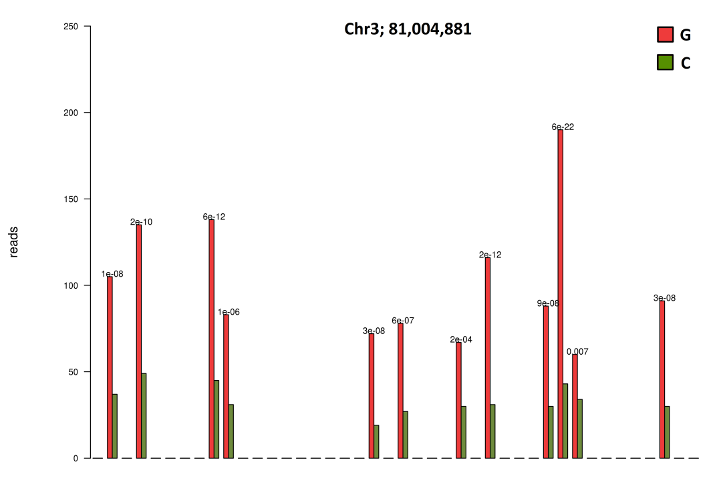
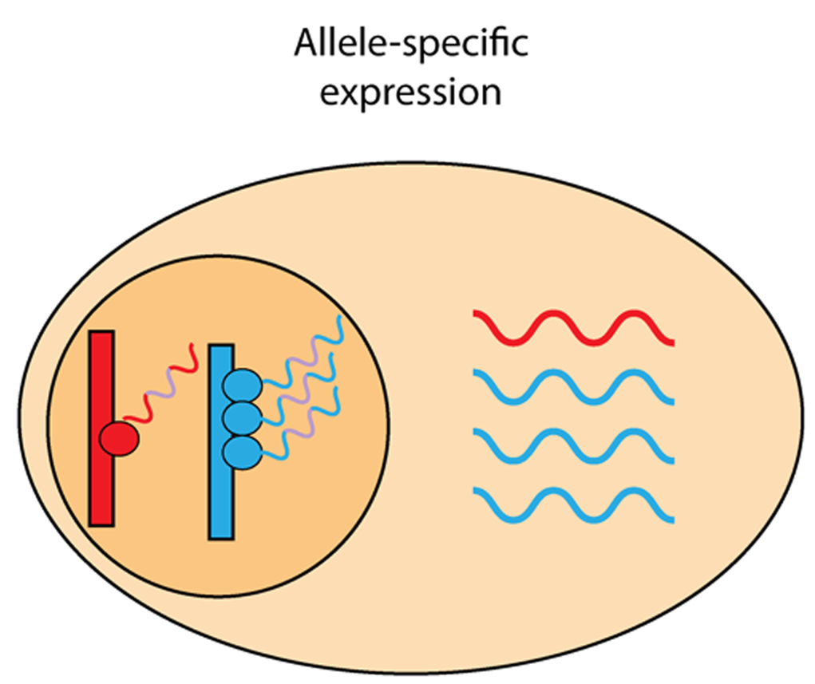
Beyond differential expression
Differential abundance of the allelic copies of a transcript

Slide 16

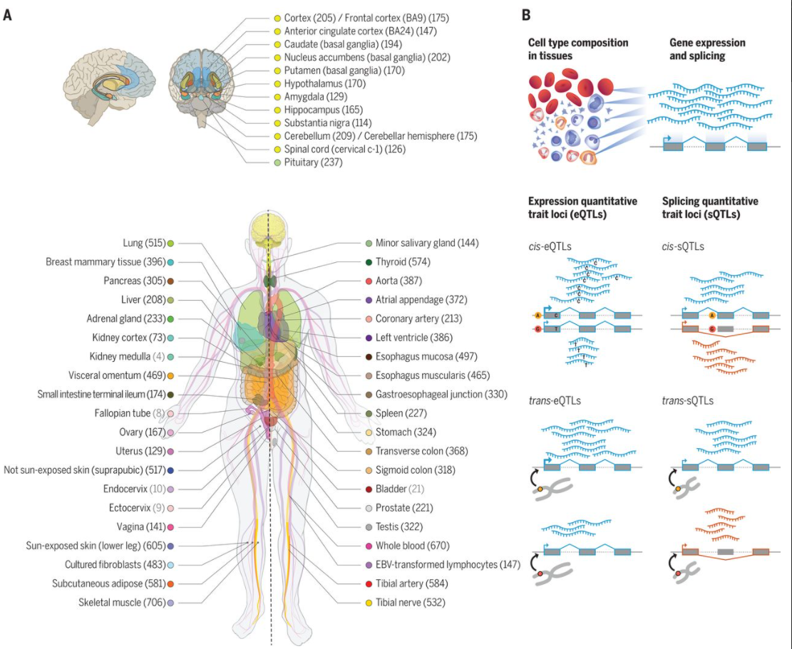
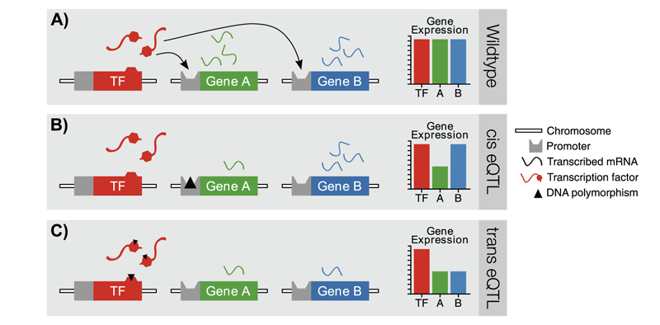
Beyond differential expression
Expression QTL: SNPs altering the expression of a gene

Slide 17
Overview of the genomics pipeline
Raw sequencing
De novo transcriptome assembly
(trinity)
Quality control
(fastp)
Alignment against the genome
(STAR)
Estimation of gene expression
(kallisto)
SNP calling
Allelic specific expression
Alternative splicing
Differential expression analysis
(DESeq2)

Slide 18
Overview of the genomics pipeline
Raw sequencing
De novo transcriptome assembly
(trinity)
Quality control
(fastp)
Alignment against the genome
(STAR)
Estimation of gene expression
(kallisto)
SNP calling
Allelic specific expression
Alternative splicing
Differential expression analysis
(DESeq2)

Slide 19
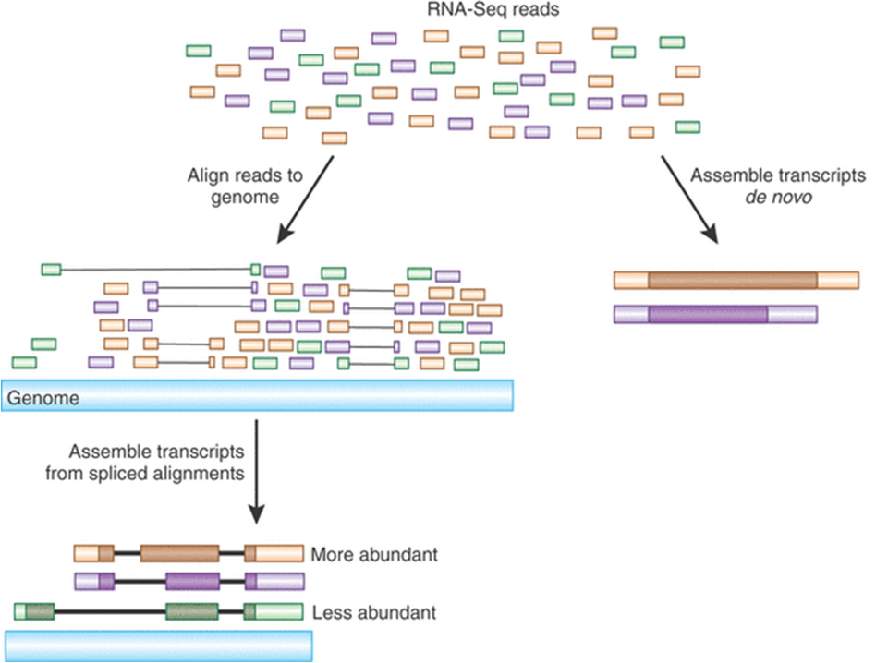
Trinity - efficient and robust de novo reconstruction of transcriptomes from RNA-seq data (https://github.com/trinityrnaseq/trinityrnaseq/wiki)

